Slide 1
Performance Characteristics: Ref.: RKR
Turbines are designed for specific values of head, speed, output, discharge, efficiency and gate opening are called designed conditions.
Required to work under varying conditions.
Essential to study their performance under various conditions-Performance Characteristics curve.
These are found by actual turbine at site or small scale turbine model at research Laboratory.

Slide 2
Characteristics curves of Turbines
Characteristic curves of hydraulic turbines are the curves with the help of which the exact behavior and performance of the turbine under different working conditions can be known. These are plotted from the results of the tests performed. the important parameters which are varied during a test are –
1.speed
2.head
3.discharge
4.power
5.overall efficiency
6.Gate opening..

Slide 3
There are 3 main and very important curves 1. Constant Head Curve 2. Constant Speed Curve 3. Constant Efficiency Curve.

Slide 4
1.Main or constant head C/C
The speed may be allowed to vary by adjusting the load on the turbine; the head and gate opening remaining constant.
These conditions can be developed only for laboratory turbines or those in the test plant and are otherwise uncommon.

Slide 5
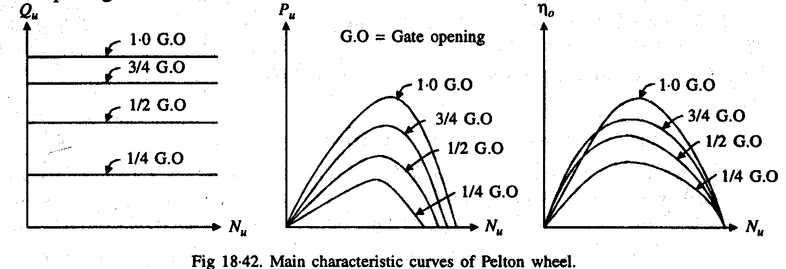
1.Main or constant head C/C

Slide 6
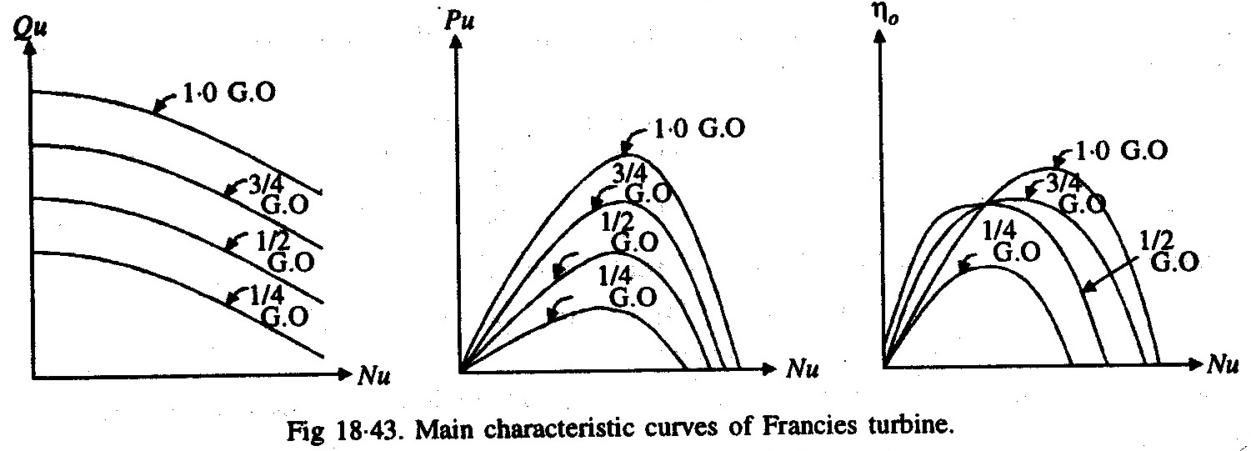
1.Main or constant head C/C

Slide 7
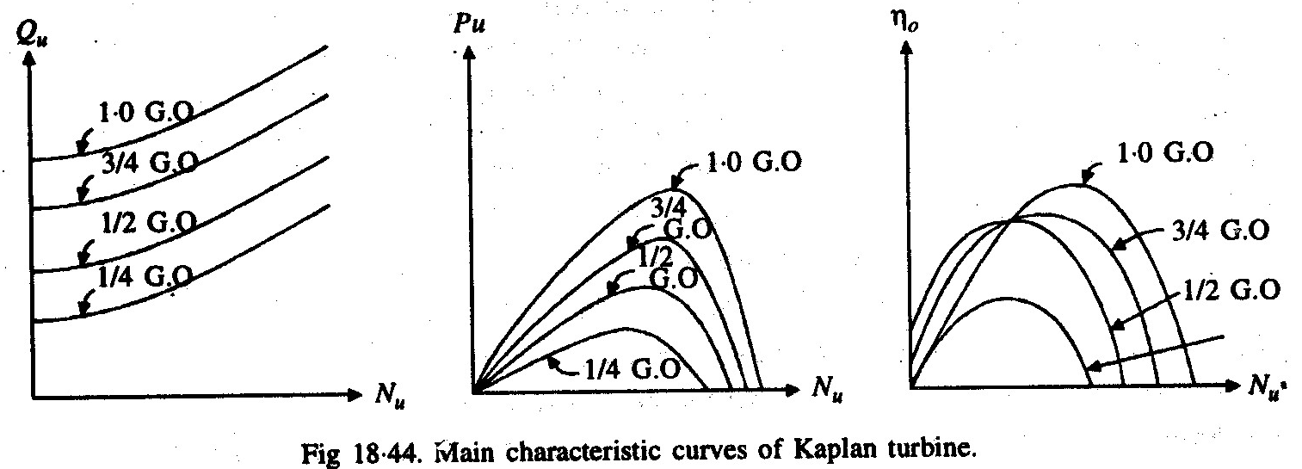
1.Main or constant head C/C

Slide 8
1.Main or constant head C/C
The discharge Qu for a pelton turbine depends only upon the gate opening and independent of Nu, so the curve are horizontal.
The curve between Qu and Nu for a francis turbine are falling. It is due to a centrifugal head develop which acts outward oppose the external head causing flow evenuially decreasing the discharge as the speed increase.

Slide 9
1.Main or constant head C/C
The curve between Qu and Nu for a Kaplan turbine are raising. Discharge increases as the speed increase.
The curve between Pu vs Nu and η_{o}vs Nu indicate that at a particular speed the efficiency is maximum.
In this head and gate opening is kept constant .Thus for every value of speed we get corresponding values of power and discharge. Thus overall efficiency can be calculated

Slide 10
2.Operating or constant speed C/C
The constant speed is attained by regulating the gate opening thereby varying the discharge flowing through the turbine as the load varies; the head and N remaining constant.
These are normal operating conditions for most of the turbines.

Slide 11
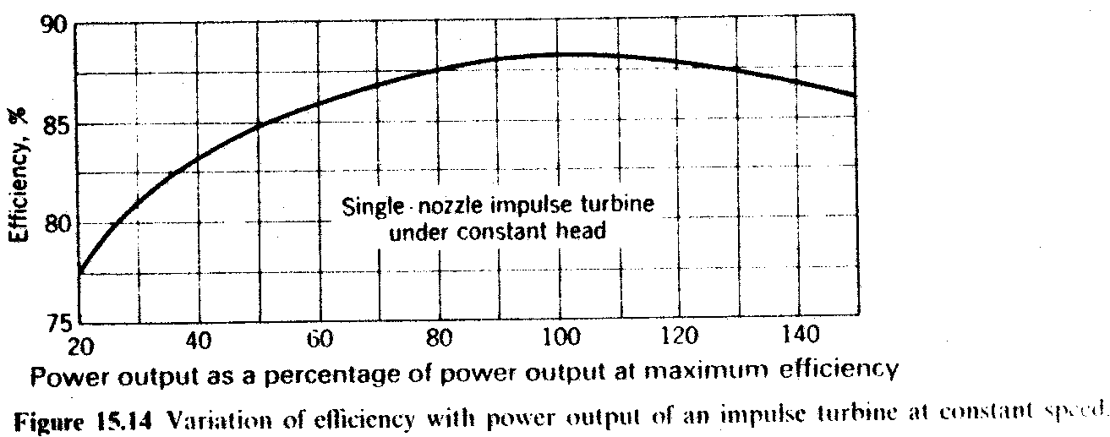
2.Operating or constant speed C/C contd.

Slide 12
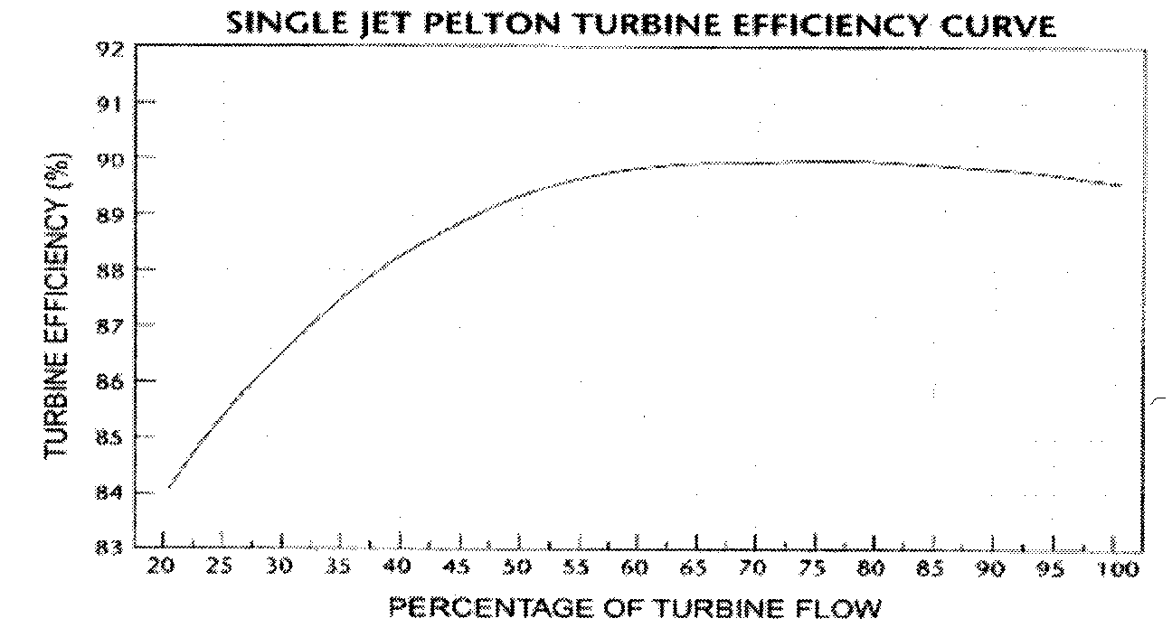
2.Operating or constant speed C/C contd.

Slide 13
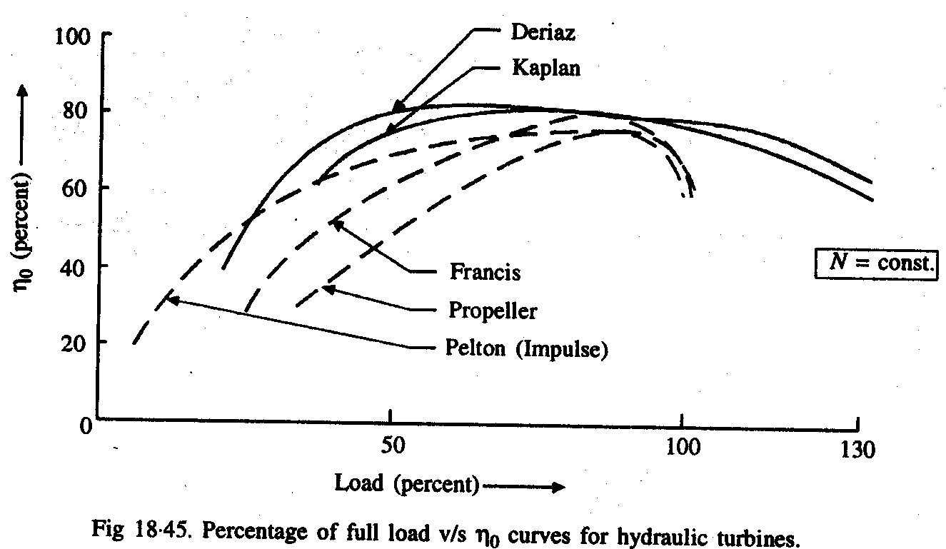
2.Operating or constant speed C/C contd.

Slide 14
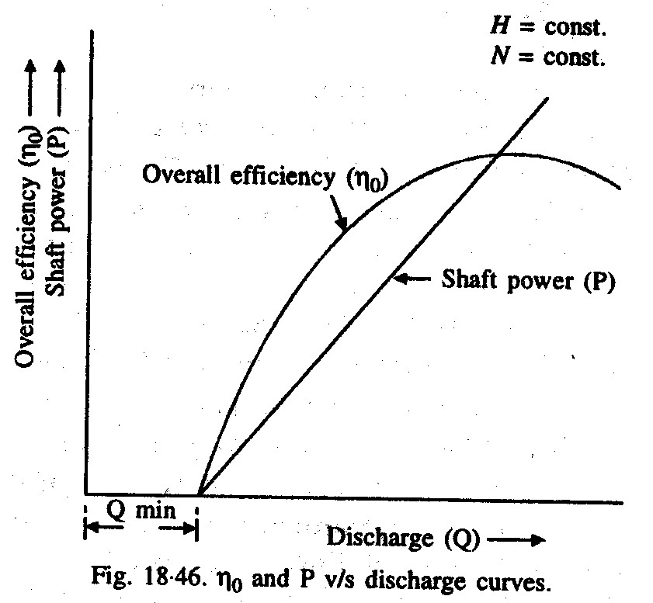
2.Operating or constant speed C/C contd.

Slide 15
2.Operating or constant speed C/C contd.
As the percentage full load increase η_{o} also increase.
At 100% full load η_{o} is near about the maximum efficiency in all case.
The Kaplan and Pelton wheel maintain a high efficiency over a larger range of part land as compared with either francis or propeller turbine.
The maximum overall efficiency of all the turbine is almost same about (85%).

Slide 16
2.Operating or constant speed C/C contd.
Shaft power (P) is a straight line, since P∝Q if H is constant.
η_{o} vs Q graph is curvilinear and η_{o} also increase with Q and remains nearly constant beyond a particular values of discharge.
In this speed and head is kept constant. thus we can find out variation in power and efficiency wrt discharge...it also helps tells us about the minimum discharge needed to overcome the friction

Slide 17
3.Constant Efficiency or iso- efficiency or Muschel curve
From Main or constant head C/C, there is two points for each value of efficiency and one value of max efficiency.
The point denoting same efficiency are joined to get constant or iso- efficiency curves or Muschel curves.

Slide 18
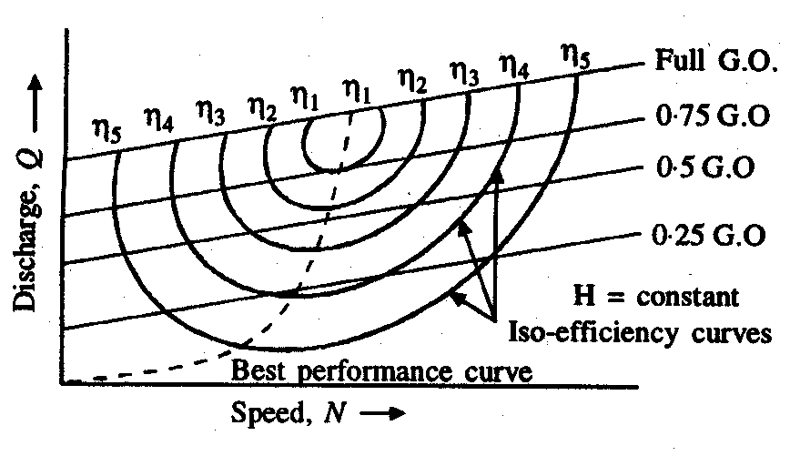
3.Constant Efficiency or iso- efficiency or Muschel curve contd.

Slide 19
3. Constant Efficiency or iso- efficiency or Muschel curve
The curve for best efficiency is obtain by joining peak point of constant or efficiency curve.
Constant efficiency curves are helpful for determining the zone of constant efficiency and for predicting the performance of the turbine at various efficiencies.

Slide 20
Thank you

